Slide 1
WorldHistGeo prep
Wireframe and Page Layout Draft

Slide 2
WorldHistGeo Wireframe draft Derrick Marr
January 27, 2021
Home Page
Create Account
Sign-in
Sample Content
Sample Interact.
Site Reviews
Submit a Review
About/ FAQs/ Contact
External Links: Free Links and Ad Space
User Auth
Main Content Page
Teach Acct
Student Acct
Course Module
Course Module
Course Module
Class List/Code
Bookmarks and Progress
Stu. List/info
Report a Problem
Stu Acct Settings
Screen Reader
Stu. Progress
Search Site
Tooltips for technical language
Teach Custom Content (later)
Teach Acct Settings
Contact Us
Wireframe of Home page, account page, and into main content page. More needs to be added for main content page. Should each of these pages have their own wire frame?

Slide 3
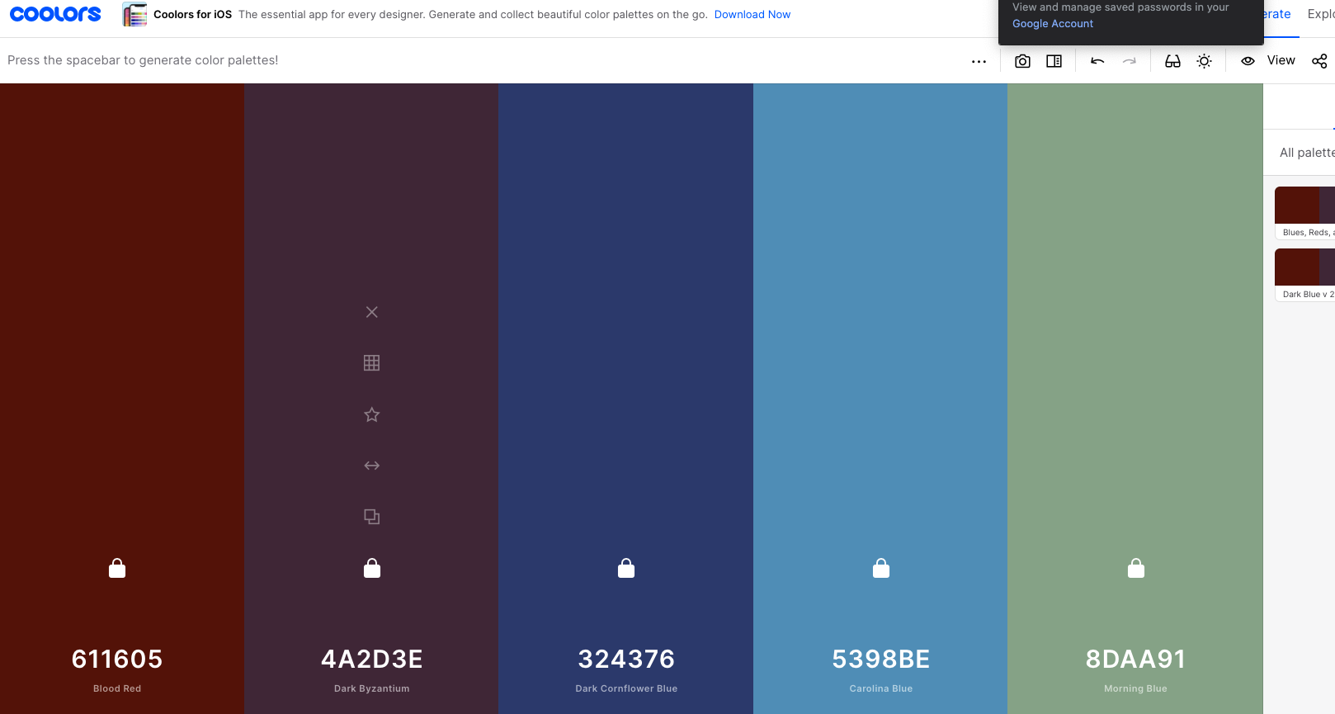
Free palette generation available at coolors.co. Draft for sure … this could change once I see it on the site.

Slide 4
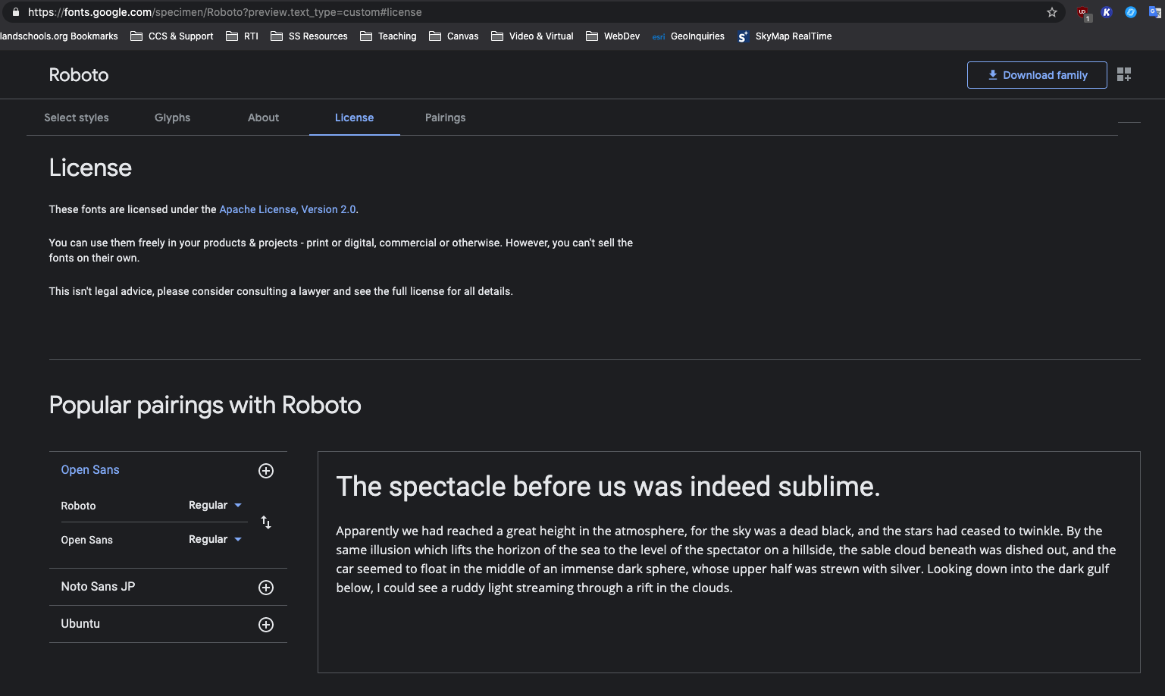
Primary fonts free from Google Fonts…
Fallback fonts will be Sans-serif, monospace, and… cursive… if I use a handwriting style font for anything.

Slide 5
The next 3 pages are publicly available.
I will focus on creating a draft of these 3 pages first. Most/all of the content on these pages (except the interactives) can be developed using my current experience with HTML, CSS, JavaScript, Bootstrap, jQuery, and SCSS. For practice, I want to make sure I incorporate each of these.

Slide 6
Home Page
Header
Create Acct // Sign-In Modal Btn(s)
About/FAQs page link
Link to Site Reviews (below)
Review this Site (below)
Contact/Partners Page
Report Broken Links/Problems
NavBar:
Brief site description…
External Links:
Ad Space, eventually for other educational or school-safe game, etc. websites
Free links may go here initially, but would likely be on partners/contact page later.
Sample Content … likely a carousel of images (people,maps, timeline, etc.), timeline of content eras, some sample text but only with visual elements included… keep it very visually engaging, especially on the home page.
Eventually multiple visual divs would be best for this, with some as static images and at least one carousel
Sample Interactive … maybe just a simple JavaScript game or two for now (John’s suggestions of Phaser.js, learning to load in sprites), can improve during the React course
Eventually multiple interactive divs, but with limited access until after sign-in and access a content area/module
Site Reviews… eventually
Submit a Review – Form? Modal? Own page?

Slide 7
Create Acct//Sign-in Modal … same or separate modal(s)??
Should Submit a review have a modal as well, or simply a form?

Slide 8
About, contact, and FAQs page

Slide 9
Contact/Partners Page
Include a list of free links, such as to state standards or other

Slide 10
PAGES AVAILABLE AFTER SIGN IN (teacher or student, all free at this point… and perhaps to stay that way?) are after this slide:
I am not sure how much of these pages will be developed during the Bootstrap course.
Some of the planned content can be developed using my current experience with HTML, CSS, JavaScript, Bootstrap, jQuery, and SCSS. For practice, I want to make sure I incorporate each of these. Other content elements can be developed as my web development skills continue to progress, especially interactive timelines, maps, games, etc. … and, of course, the back end for user submissions.

Slide 11
Teacher User Account Page (accessible only after sign-in)
LAYOUT STUDENT ACCOUNT PAGE FIRST, THEN COPY OVER THIS Temporary TEACHER one and make appropriate changes, including a student view…
Plan to follow the same approach for the actual page coding since many elements should be in common between the two.

Slide 12
Student User Account Page (accessible only after sign-in)
Search this Site

Slide 13
Main Content Page (accessible only after sign-in)
Search this Site

Slide 14
First Content Page – Age of Exploration … more to follow over time …
Search this Era/Site

